Slide 1
Intro to Hacking with the Raspberry Pi
Follow along! www.sarahwithee.com/raspberrypi
Sarah Withee (@geekygirlsarah)

Slide 2































Titanium Sponsors
Platinum Sponsors
Gold Sponsors

Slide 3

What is the Raspberry Pi?
“The Raspberry Pi is a credit-card sized computer that plugs into your TV and a keyboard. It is a capable little computer which can be used in electronics projects, and for many of the things that your desktop PC does, like spreadsheets, word-processing and games. It also plays high-definition video. We want to see it being used by kids all over the world to learn programming.”
-- raspberrypi.org/faqs

Slide 4
What is “hacking”?
“We are taking back the term ‘Hacking’ which has been soured in the public mind. Hacking is an art form that uses something in a way in which it was not originally intended. This highly creative activity can be highly technical, simply clever, or both. Hackers bask in the glory of building it instead of buying it, repairing it rather than trashing it, and raiding their junk bins for new projects every time they can steal a few moments away.”
-- hackaday.com/about/

Slide 5
Disclaimer
This IS a workshop…
for integrating the Pi into fun hacking projects…
for learning to program with sensors, LEDs, and more
for learning to build sample projects to inspire you to build your own projects

Slide 6
Disclaimer
This is NOT a workshop…
on how to use Linux
on how to install a Raspberry Pi OS
for advanced electronics
on general programming. (It’s a regular computer, you can write code as normal)
I’ll include links at the end for these

Slide 7
Breakdown
Raspberry Pi Information
Intro to Hardware
Project 1 (LEDs) – Cylon/Knight Rider Lights
Project 2 (LCD Screen) – Bouncy Ball
Project 3 (Sensors) – Distance Tracker
Other Ideas
More Information and Conclusion

Slide 8
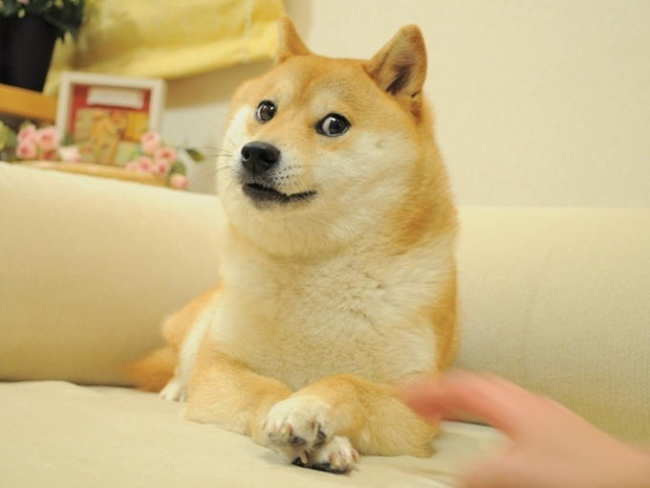
very code
much resources
how to pi
total wow
www.sarahwithee.com/raspberrypi

Slide 9
Raspberry Pi Information
Intro Pi > Intro Hardware > LEDs > LCD > Sensors > More Ideas > Conclusion

Slide 10
History of the Raspberry Pi
2006 – Had idea for affordable computer for kids
2008 – Processors started to get cheap enough to make it a feasible project
2011 – Model B entered mass production
2013 – Sold > 2,000,000 units
2015 – Pi 2 Model B released

Slide 11
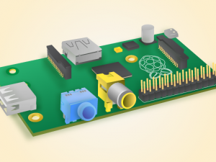
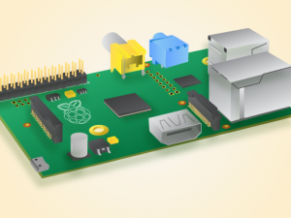
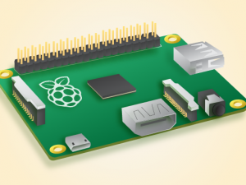
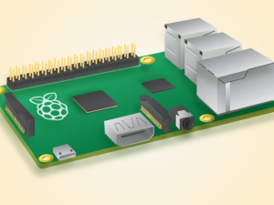
Raspberry Pi Models
 | Model A | Model B | Model A+ | Model B+ | 2 Model B
Processor | 700 MHz | 700 MHz | 700 MHz | 700 MHz | 4x 900MHz
Memory | 256 MB | 512 MB | 256 MB | 512 MB | 1 GB
Expansion | Full SD | Micro SD | Full SD | Micro SD | Micro SD
USB Ports | 1 | 2 | 1 | 4 | 4
Ethernet | No | 10/100 | No | 10/100 | 10/100
A/V | HDMI, composite | HDMI, composite | HDMI, 3.5mm jack | HDMI, 3.5mm jack | HDMI, 3.5mm jack
GPIO Pins | 26 | 26 | 40 | 40 | 40
Power | 300mA*, 1.5W | 700mA*, 3.5W | 200mA*, 1W | 600mA*, 3W | 800mA*, 4W
Cost | $25 | $35 | $20 | $30 | $35
* Barebones Pi with no peripherals attached. 1.2A minimum power supply recommended.

Slide 12
Intro to Hardware
Intro Pi > Intro Hardware > LEDs > LCD > Sensors > More Ideas > Conclusion

Slide 13
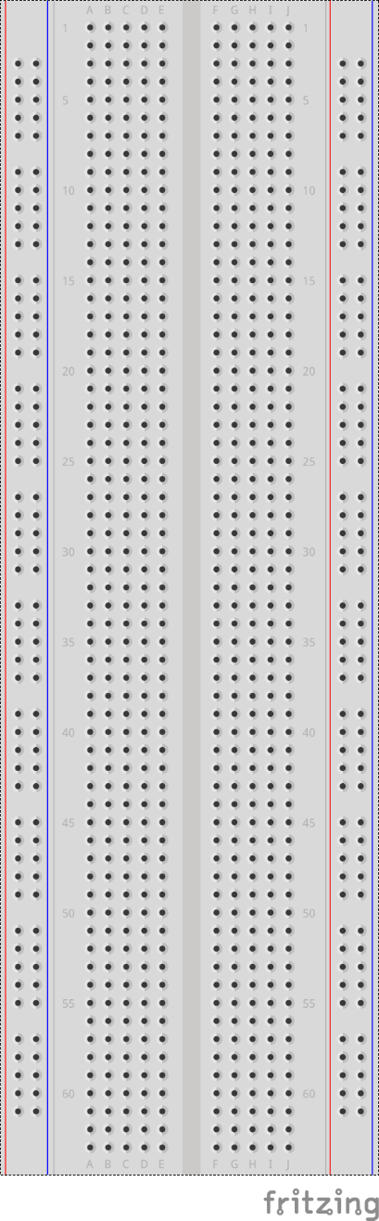
What Is a Breadboard?
A type of board used for prototyping
Each row of 5 is connected
Each column of 50 is connected
Columns on side are power rails:
Red provides power (3.3 or 5 volts from source)
Blue provides ground (power back to source)
Any wire plugged into a row is connected to any other wire in the same row

Slide 14
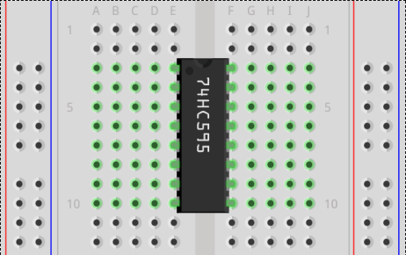
What Is a Breadboard?
Each row of 5 holes are connected to each other
Each column of holes are connected together
Why?
Each row is designed to allow multiple wires to plug into an integrated circuit chip.
Why?
Columns are designed to allow easy way to provide power and ground for all components

Slide 15
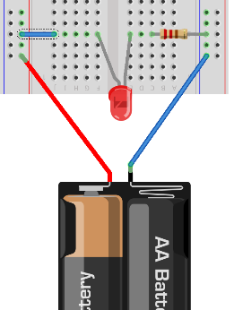
Making a Circuit
Electricity must flow in a full circle from source, through elements, back to the source
Source of power is called positive terminal
Must return back to the source at negative terminal
In this example, power flows:
Battery + | → | Red rail
 | → | Blue wire
 | → | LED
 | → | Resistor
 | → | Blue rail
 | → | Battery -

Slide 16
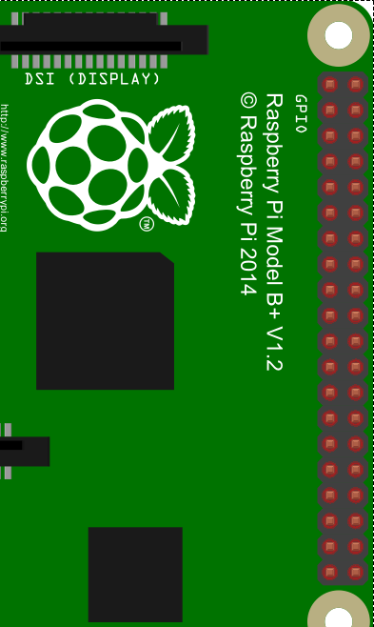
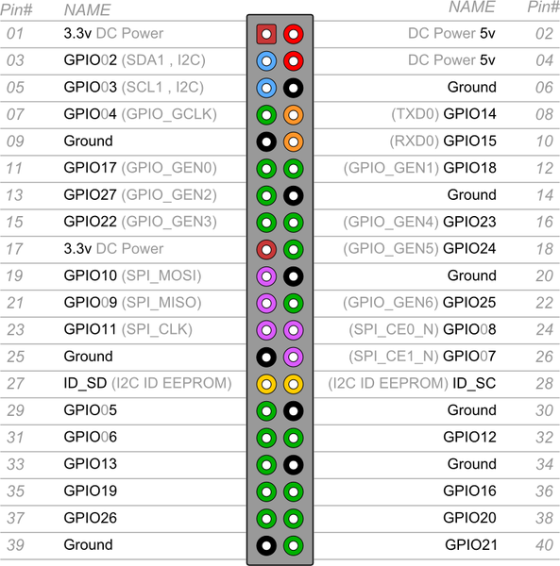
Powering Circuits

Slide 17
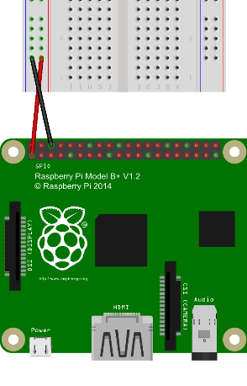
Powering Circuits
Outgoing Power:
Pi provides 3.3 volts (V) and 5 volts
Often labelled as +3.3V, +5V, or Vcc
This is the “positive terminal”
Return Power:
Often labelled as Ground or GND
Most devices have several of them, you can use any of them
Typically we wire +3.3/+5 to red rail and GND to blue rail on breadboard

Slide 18
General Purpose Input/Output (GPIO)
Raspberry Pi provides 26 or 40 pins, depending on mode.
40 pins (A+, B+, 2 B) are backward compatible with 26 pins (A, B)
Two +5V, Two +3.3V, Eight Ground
Others are “general purpose”, meaning can be input or output based on programming
Output pins send +3.3V
Some pins have special purposes and can’t be swapped

Slide 19
Programming GPIO Pins
Python (and other languages) for Pi include GPIO library
Python’s requires:
At start, must set output mode:
Board – physical pin #
BCM – GPIO pin #
My examples use Board
At end, must exit cleanly:
import RPi.GPIO as GPIO
GPIO.setmode(GPIO.BOARD)
GPIO.setmode(GPIO.BCM)
GPIO.cleanup()

Slide 20
Programming GPIO Pins
For each GPIO pin used, you must set it up as input or output first:
Can read/write to it with functions:
GPIO.setup(3, GPIO.OUT) GPIO.setup(4, GPIO.IN)
GPIO.output(3, True) # +3.3V
GPIO.output(3, GPIO.HIGH)
GPIO.output(3, False) # 0V
GPIO.output(3, GPIO.LOW)
x=GPIO.input(4) # Bool or
# 0/1

Slide 21
Project 1 (LEDs) – Cylon/Knight Rider Lights
Intro Pi > Intro Hardware > LEDs > LCD > Sensors > More Ideas > Conclusion

Slide 22
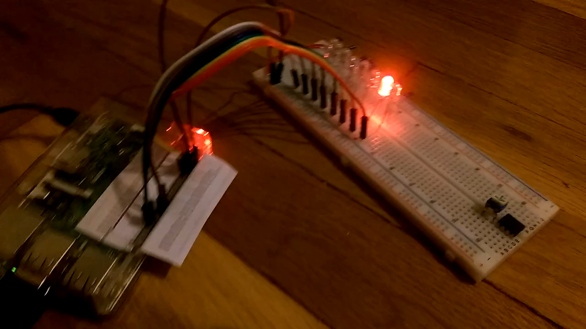
Demo

Slide 23
Materials List
Raspberry Pi (any model)
Power supply (I recommend at least 1.5A for this project)
1 Breadboard
8 light emitting diodes*
8 resistors*
9 jumper wires
* I’ll explain these in a minute

Slide 24
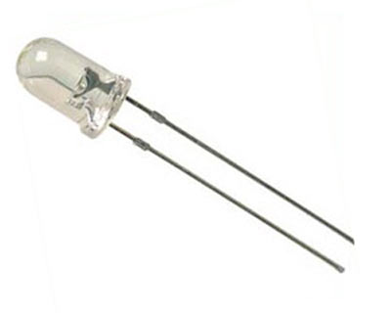
Light Emitting Diodes (LED)
Diode – Electronic device that allows electricity to flow in one direction
Anode – longer wire (+)
Cathode – shorter wire (-)
When power is applied (correctly), it glows. If incorrect, nothing happens
Resistor needed otherwise LED will glow bright white then fry
I recommend just buying LED packs that include resistors with them

Slide 25
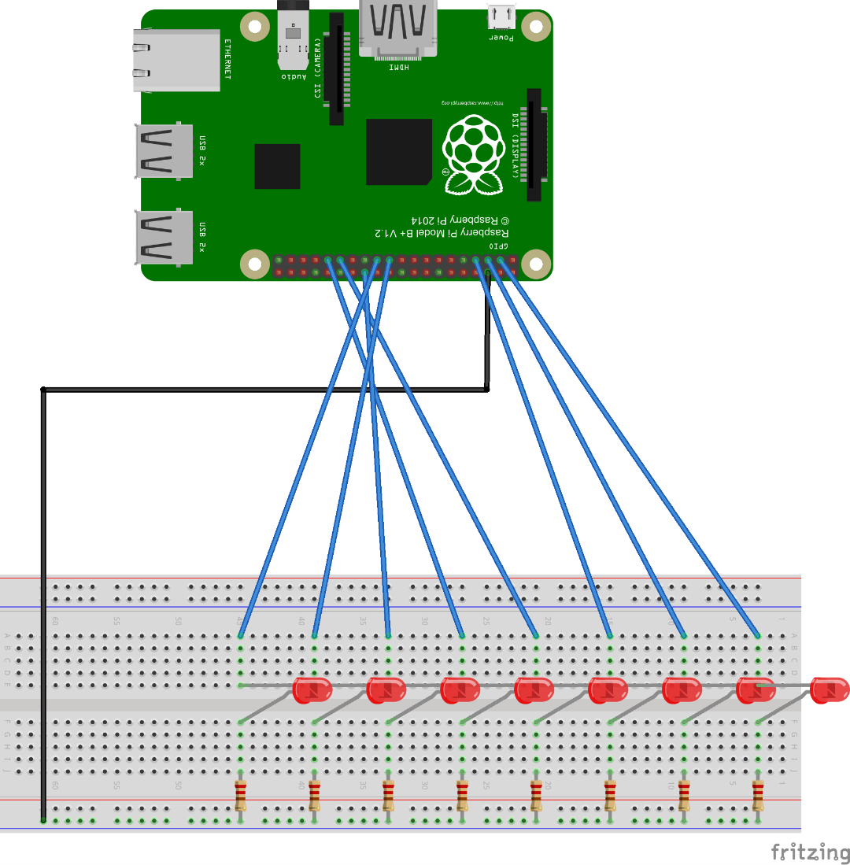
Hardware Layout
Pi GND -> blue rail
(+3.3V rail not needed)
Pi GPIO 2-10 -> LED’s anodes (longer wire)
LED’s cathode (shorter wire) -> resistor
Resistors -> blue rail

Slide 26
Hardware Layout
Programmatically turn on power to blue wires
Return to GND
Through LED & Resistor
Through blue GND rail

Slide 27
Code
# Import libraries
import time
import RPi.GPIO as GPIO
# Create array of GPIO pins
pins = [3, 5, 7, 29, 31, 26, 24, 21]
# Speed lights will blink (secs)
speed = .2

Slide 28
Code
# Set GPIO pins to board (physical pins) mode
GPIO.setmode(GPIO.BOARD)
# Set up all pins as output pins
for i in pins:
GPIO.setup(i, GPIO.OUT)

Slide 29
Code
while True:
# Loop forward
for i in range(len(pins)):
GPIO.output(pins[i], True)
time.sleep(speed)
GPIO.output(pins[i], False)
# Loop backward
for i in range(len(pins)-1, -1, -1):
GPIO.output(pins[i], True)
time.sleep(speed)
GPIO.output(pins[i], False)

Slide 30
Demo

Slide 31
Project 2 (LCD Screen) – Bouncy Ball
Intro Pi > Intro Hardware > LEDs > LCD > Sensors > More Ideas > Conclusion

Slide 32
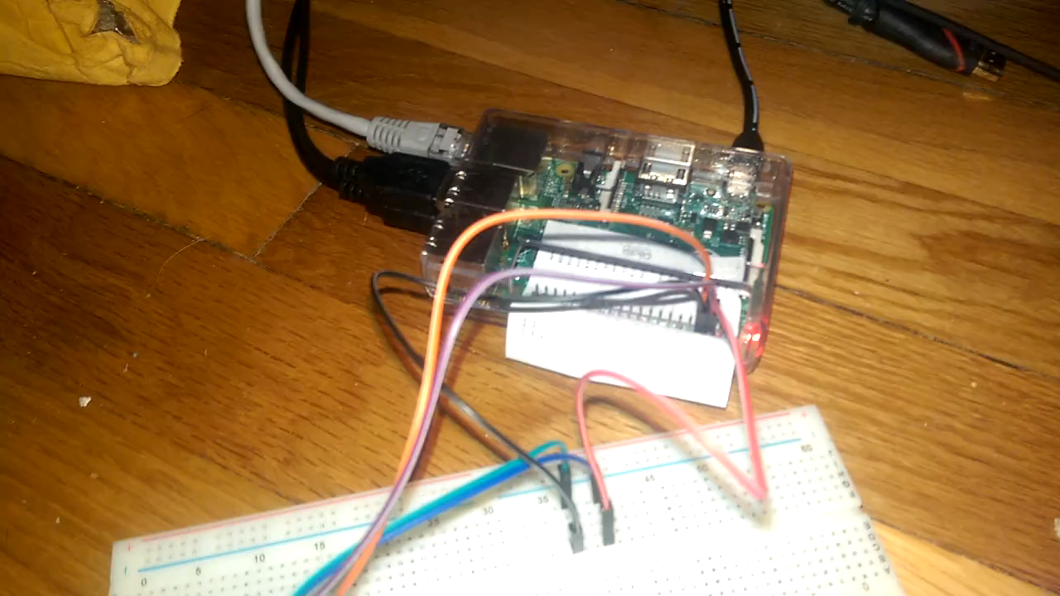
Demo

Slide 33
Materials List
Raspberry Pi (any model)
Power supply (I recommend at least 1.5A for this project)
4 jumper wires (female to female)
1 Breadboard (needed if you have other wires)
1 LCD screen
They vary in size/shape/color/etc. Use one with I2C or Serial capabilities

Slide 34
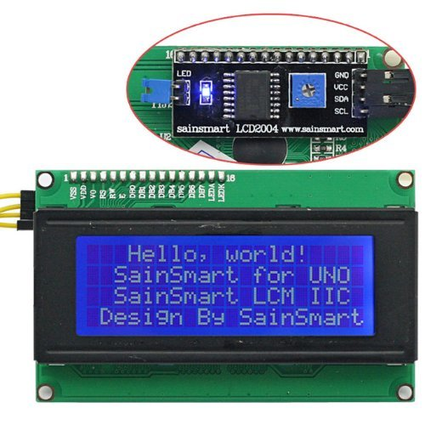
LCD Screen
Uses 4x20 characters per screen
Each character is 8x5 pixels
Can add custom characters
Really easy to use with serial or I2C chip on the back
Does have small delay when writing/erasing screen

Slide 35
I²C
“Inter-Integrated Circuit”, pronounced “I squared C”
Communications protocol for circuitry
Uses master/slave bus
Each device has an address and can be contacted by it
Communication shares the same 2 wires for all devices connected: SDA, SCL
A lot of support is built into various hardware (Raspberry Pi, Arudinos, Beaglebones, etc.)

Slide 36
I²C
Must be enabled in Raspberry Pi first
Run: sudo raspi-config
Choose Advanced options
Choose I2C
Choose to enable it
Choose to enable it on startup

Slide 37
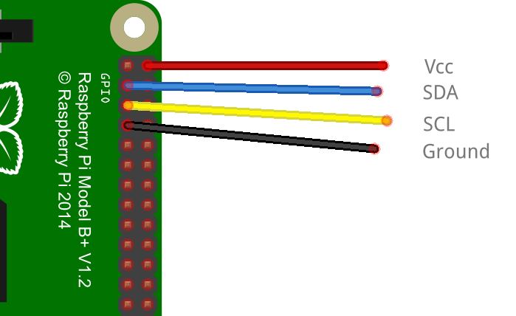
Wiring
No breadboard needed if using female-to-female wires
Use breadboard as jumping point otherwise
Raspberry Pi | LCD Screen
+5V | Vcc
SDA (GPIO3) | SDA
SCL (GPIO5) | SCL
Ground | Gnd

Slide 38
Code
# Requires RPi_I2C_driver.py for I2C and LCD
# This is on my website
import RPi_I2C_driver
from time import *
# Create the object
mylcd = RPi_I2C_driver.lcd()

Slide 39
Code
# Print happy welcome message on lines 1 and 3
mylcd.lcd_display_string("Welcome to", 1)
mylcd.lcd_display_string(" Nebraska.Code() !!", 3)
sleep(2) # 2 sec delay
# Erase screen
mylcd.lcd_clear()

Slide 40
Code
# These are the char codes to start writing on each of the 4 rows
rows= [0x80, 0xC0, 0x94, 0xD4]
x = 0
y = -1
changex = 1
changey = 1

Slide 41
Code
while True:
x = x + changex
y = y + changey
if x < 2:
changex = 1
x = 1
if x >= 4:
changex = -1
if y < 1:
y = 0
changey = 1
if y >= 19:
changey = -1

Slide 42
Code
mylcd.lcd_clear()
mylcd.lcd_display_string_pos("o",x,y)
sleep(.5)

Slide 43
Demo

Slide 44
Project 3 (Sensors) – Distance Tracker
Intro Pi > Intro Hardware > LEDs > LCD > Sensors > More Ideas > Conclusion

Slide 45
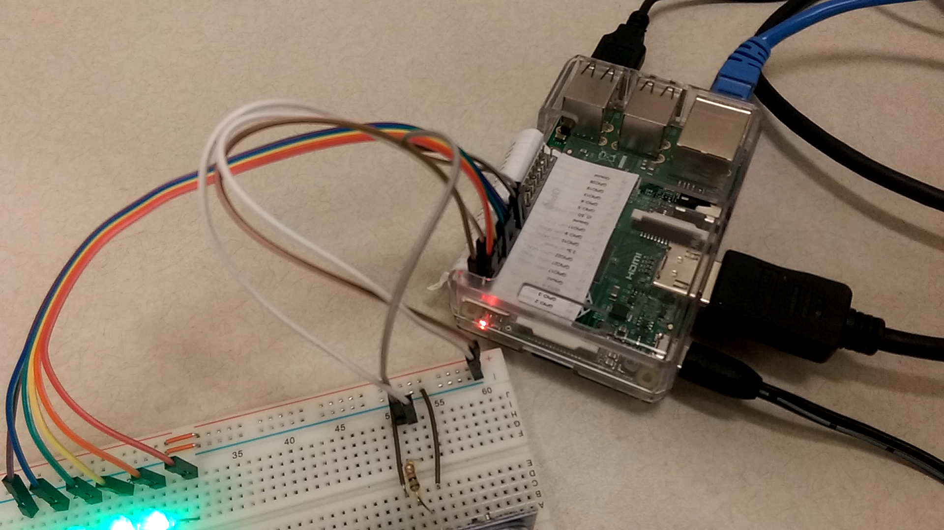
Demo

Slide 46
Materials List
Raspberry Pi (any model)
Power supply (I recommend at least 1.5A for this project)
1 Breadboard
1 ultrasonic sensors (HC-SR04)
1 1kΩ resistors
6 LEDs
6 220Ω resistors
Lots of wires

Slide 47
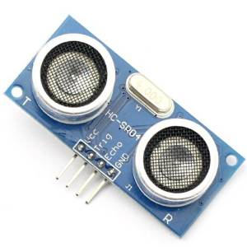
Ultrasonic Sensor
Ultrasonic sensors are one of a variety of sensors you can use
They detect distance with sound
Ultrasonic = outside of human hearing range
Pulses 40KHz signal from “T” side
“R” side listens for it
Time taken in between is time for sound to travel

Slide 48
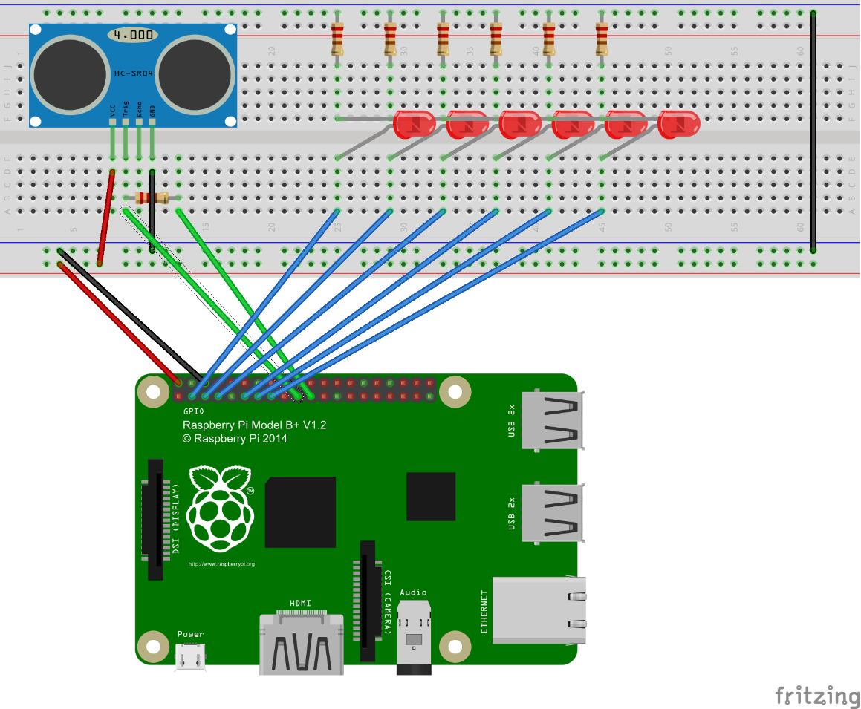
Wiring
Breadboard Ground -> Pi Ground
Breadboard +5V -> Pi +5V
Sensor Gnd -> Gnd rail
Sensor +5V -> +5V rail
LEDs similar to Project 1

Slide 49
Wiring
LED anodes to pins 3, 5, 7, 11, 13, 15 (9 is a ground, skip it)
Sensor Trigger to 19
Sensor Echo to 21

Slide 50

Wiring

Slide 51
Code
import time
import RPi.GPIO as GPIO
# Set up the pins
uTrig = 19
uEcho = 21
leds [3, 5, 7, 11, 13, 15]
GPIO.setup(GPIO.BOARD)
for i in leds:
GPIO.setup(i, GPIO.OUT)
GPIO.output(I, GPIO.LOW) # off

Slide 52
Code
def reading(trigger, echo):
GPIO.setwarnings(False)
GPIO.setmode(GPIO.BOARD)
GPIO.setup(trigger, GPIO.OUT)
GPIO.setup(echo ,GPIO.IN)
GPIO.output(trigger, GPIO.LOW)
time.sleep(0.3)

Slide 53
Code
GPIO.output(trigger, True)
time.sleep(0.00001)
GPIO.output(trigger, False)
signaloff = 0
while GPIO.input(echo) == 0:
signaloff = time.time()

Slide 54
Code
signalon = 0
while GPIO.input(echo) == 1:
signalon = time.time()
timepassed = signalon - signaloff
distance = timepassed * 17000
return distance

Slide 55
Code
# Main program
while True:
# Grab a reading
read = reading(u1Trig, u1Echo)
for i in range(0, 6):
print(i)
if read > i * 3:
GPIO.output(leds[i], GPIO.HIGH)
else:
GPIO.output(leds[i], GPIO.LOW)

Slide 56
Demo

Slide 57
More Project Ideas
Customized cookie maker machine
Tracking cat/dog door
Show tweets/emails on LCD screen
AI-programmed remote control cars
Robots… of any variety…
Turn on/off heater/AC when a room is occupied/unoccupied

Slide 58
More Information and Conclusion
Intro Pi > Intro Hardware > LEDs > LCD > Sensors > More Ideas > Conclusion

Slide 59
Buying Parts
Where can I buy parts?
Raspberry Pi
Power supply – Amazon (mine’s 3.5A), $19
Breadboard – MicroCenter, $6
LEDs – Amazon or electronic stores (find set with LEDs and resistors together), $6 for 50
Ultrasonics (HC-SR04) – Amazon, $25 for 5
…

Slide 60
Resources
Raspberry Pi site: raspberrypi.org
Hack A Day: hackaday.com/

Slide 61
Lessons Learned
Don’t plan a conference talk while still a very active student
Hardware sometimes fails randomly. If software quits working, try testing the hardware
Development always takes longer than you expect it to. Hacking projects are the same.

Slide 62
Conclusion
Raspberry Pi is more than just a PC, it can interface with other electronics
You’ve seen some sample projects
You’ve seen how to code items like sensors, LCD screens, and LEDs
Hopefully you’re inspired to use these ideas to do your own projects

Slide 63
Contact Me
Twitter: @geekygirlsarah
Email: sarah@sarahwithee.com
Slides/Resources: sarahwithee.com/raspberrypi
Feel free to contact with questions or to show off projects
Check out the projects before you leave!

